Slide 1
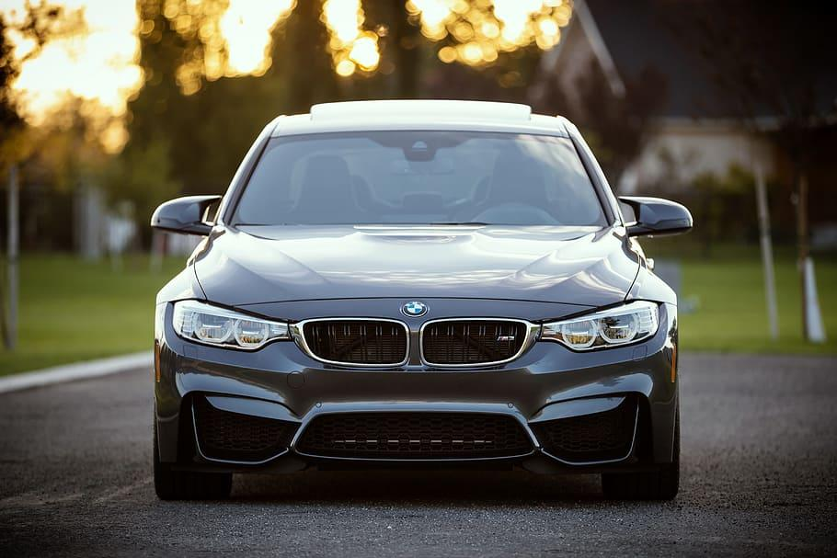

Dynamic VR Cabin (DVC)
Student Members:
Asad Melibaev
Lev Oleynik
Enoch Shen
Drew Hering

Slide 2
Weeks 1 - 3
Date: September 29th to October 17th

Slide 3
What have done this week (Overview)
Preparing and Research (Asad Melibaev)
Discussed budget constraints within companies and how to order parts
Practiced Unreal Engine 5 blueprinting
Apple Vision Pro (Lev Oleynik)
Did Research and Setup of Unreal Engine VR environment on Apple Vision Pro
Meta Quest 3 (Enoch Shen)
Learn how to use the Meta Quest 3
Research Travel Mode
“Are we able to run VR in a moving vehicle?”
Research (Drew)
OBD reader, AMU, UDP

Slide 4
Weeks 4
Date: October 17th to October 24th

Slide 5
What have done this week (Overview)
Interlinking Data(Asad Melibaev)
Ros2, Learning how to obtain sensor data from steering wheel rotation and scents
Unreal Engine 5 in Vision Pro…. (Lev Oleynik)
Setup Unreal Engine, Xcode, Vision Pro environment.
Unreal Engine 5 (Enoch Shen)
Familiarize with Unreal Engine 5
Build or find a demo car interior
Ensure that car meshes are separate (independent steering wheel)
Designed Custom Steering Wheel Sensor

Slide 6
Weeks 5
Date: October 25th - 31st

Slide 7
What have done this week (Overview)
Preparing and Research (Asad Melibaev)
Researched into the bmw specific sensors and accessing the data from them
Looking into what kind of data we can access from the obd reader
Apple Vision Pro (Lev Oleynik)
Research Scent Sensors viability, other practical sensors to measure information
Setup VR environment in Vision Pro
Unreal Engine 5 to Meta Quest 3 (Enoch Shen)
Upload a demo VR world onto the Meta Quest 3
Build a ‘.apk’ file and upload it.
Ensure it can run independently
Research (Drew)
Refined wheel sensor design, created BOM, researched UDP to UE5 connection

Slide 8
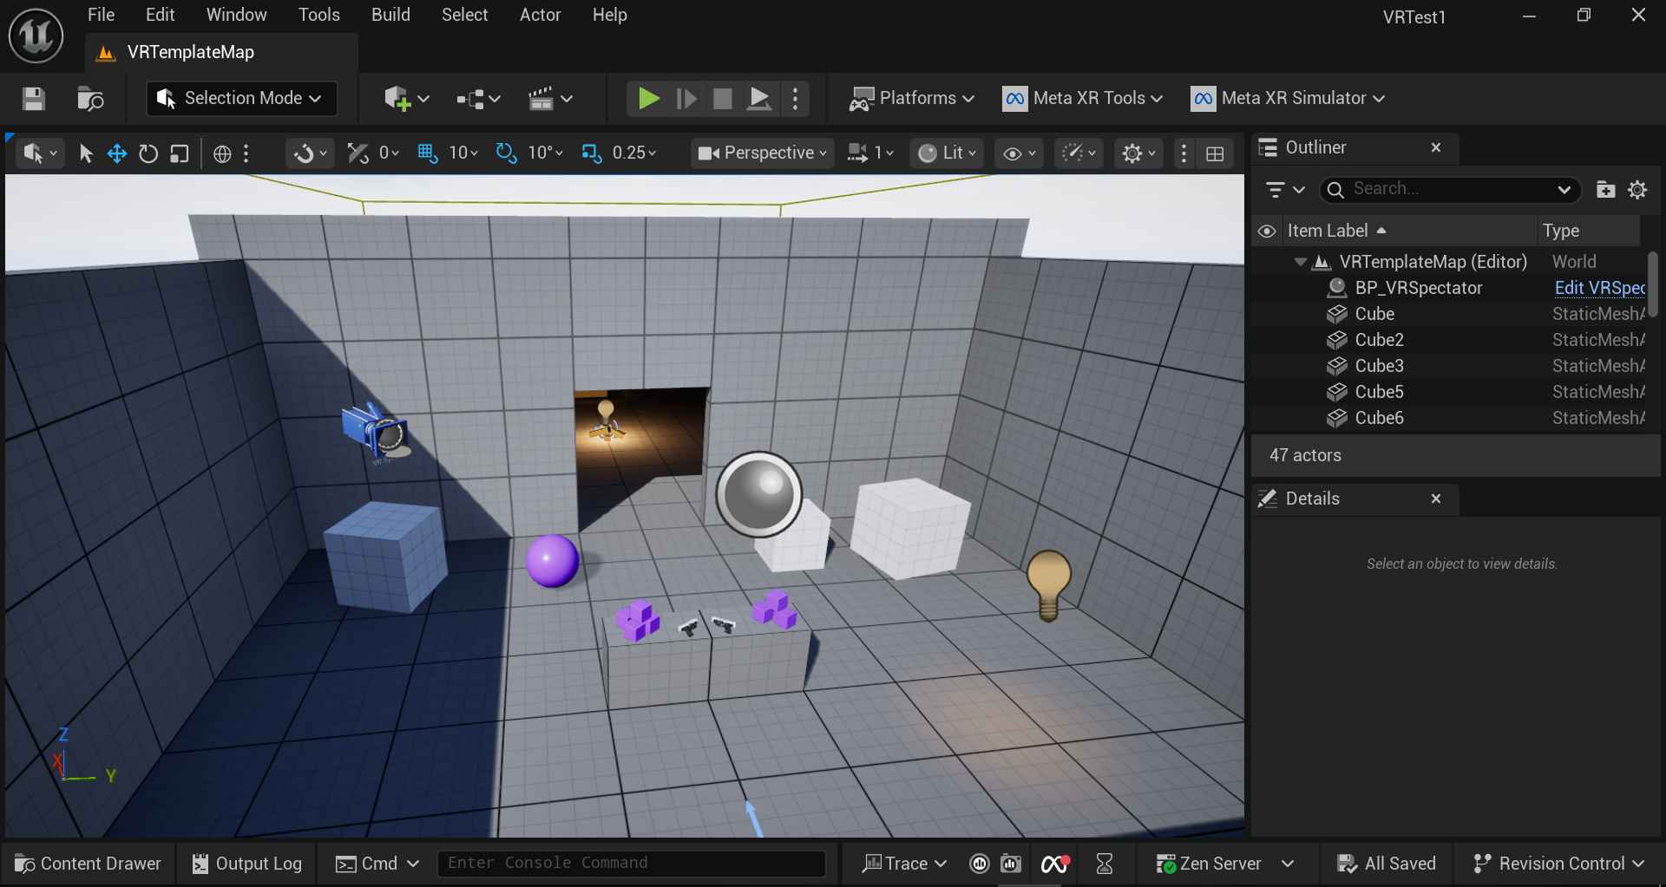
Unreal Engine 5 VR Demo World

Slide 9
Weeks 6
Date: November 1st - 7th

Slide 10
What have done this week (Overview)
Preparing and Research (Asad Melibaev)
Looked into ADAS systems and how we could potentially incorporate the next data stream into a digital twin of our car
Sensor-Wheel Mount (Lev Oleynik)
Develop 3D CAD model for sensor wheel mount.
Continue Virtual Environment Development with Apple Vision Pro
Demo Car Environment (Enoch Shen)
Build a car environment example on Unreal Engine 5
Upload this onto the Meta Quest 3
UDP Compatibility (Drew)
Started UDP to UE5 connection

Slide 11
Weeks 7
Date: November 8th - 14th

Slide 12
What have done this week (Overview)
Preparing and Research (Asad Melibaev)
Continue learning ROS and ADAS sensors that we could incorporate into our vehicle
Reading different research papers and articles on the topic
Sensor-Wheel Mount (Lev Oleynik)
Continue development 3D CAD model for sensor wheel mount. Update measurements, begin testing.
Begin research on Camera Sensor for further Integration
UDP Unreal Engine Mesh (Enoch Shen)
Combined UDP Network Connections to Unreal Engine
Mesh Unreal Engine connections
Established UDP - UE5 connection (Drew)
Created & uploaded tutorial to the shared drive

Slide 13
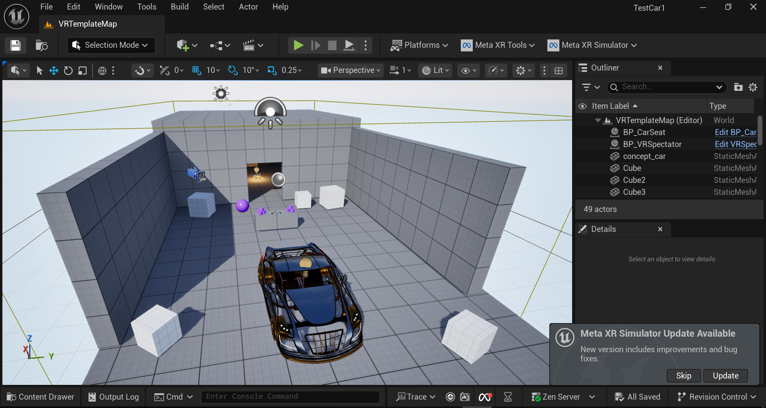
Unreal Engine Car Demo

Slide 14
Weeks 8
Date: November 15th - 21st

Slide 15
What have done this week (Overview)
Writing Code for sensor data input (Asad Melibaev): …
Once the sensor components arrive, look into streaming and timestamping the data into the computer
Modeling / Camera Sensor (Lev Oleynik): …
Research Camera Sensor
Print and finish 3D Model for Steering-Wheel Sensor
Test OBD Sensor
UDP to Unreal Engine 5 Connection (Enoch Shen)
Combine UDP Unreal Engine 5 Program with previously made Car Demo World
Build this onto the .apk file onto the quest 3.
Used Tailscale to Create a VPN Network (Drew Hering):
Used Tailscale to create a VPN network for remote access.

Slide 16
Weeks 9 - 10
Date: November 22nd - December 5th

Slide 17
What have done this week (Overview)
Digital Twin (Asad Melibaev): …
Create digital twin of drew's car in unreal engine using the standard car template
Make parts list for the adas system
Modeling / Camera Sensor (Lev Oleynik): …
Part-List for ADAS System
Print and finish 3D Model for Steering-Wheel Sensor
UDP to Unreal Engine 5 Connection (Enoch Shen)
Merge VR project with the unreal engine car template
Used Tailscale to Create a VPN Network (Drew Hering):
Used Tailscale to create a VPN network for remote access.

Slide 18
To-do list for over the break
(Asad Melibaev):
(Lev Oleynik):
(Enoch Shen)
(Drew Hering):

